Slide 1
10X analysis of Foreign and islet reactive cd4 conventional and regulatory t cells
Thomas H. Edwards
Bioinformatician I
20241031

Slide 2
Overview
Background & Motivation
T cells in Type 1 Diabetes
Prior work
Current Study
Data & Results

Slide 3

Acknowledgements
Bioinformatics Core
Hannah DeBerg
Stephan Pribitzer
Matt Dufort
Alex Hu
Matt Lawrence
Ty Bottorff
Andrew Koval
Kenneth Lai (2023 intern)
Genomics Core
Vivian Gersuk
Kimberly O’ Brien
CATA Core
Adam Wojno
Cerosaletti Lab
Karen Cerosaletti
Janice Chen
Software & Data Management
Charlie Quinn
Alex Walker
Adarsh Manjunath
Anna Bjork
Robyn Meshulam
Seattle Children’s Research Center
David J. Rawlings

Slide 4
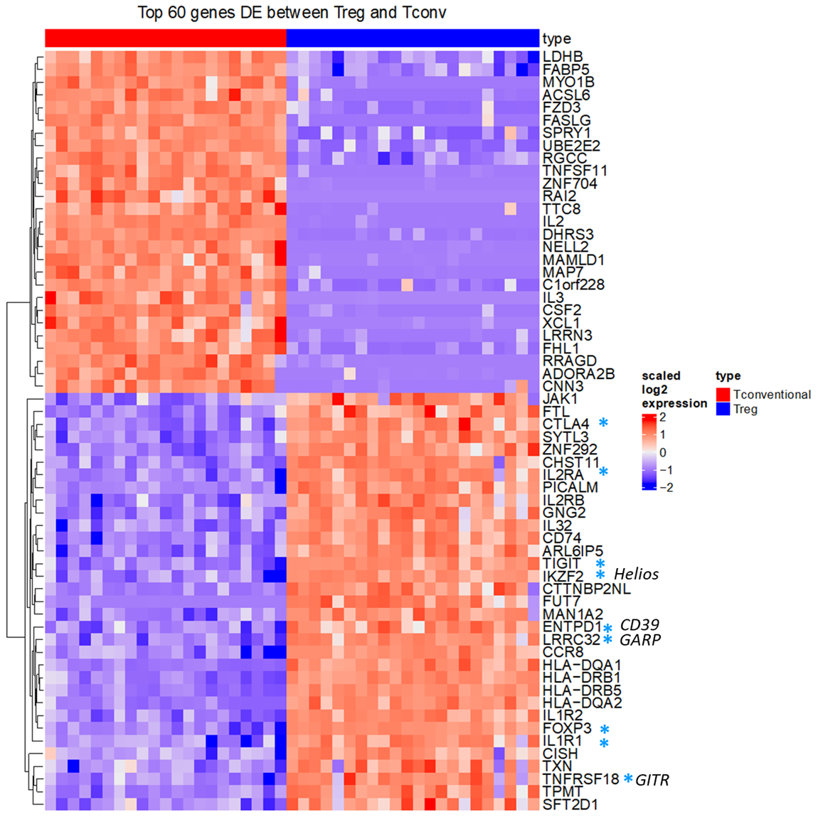
Islet Tregs are transcriptionally distinct from Tconv cells
P390 plate sorted islet Tconv and Treg
Alex Hu
Notes:
1102 Treg / 2568 Tconv

Slide 5
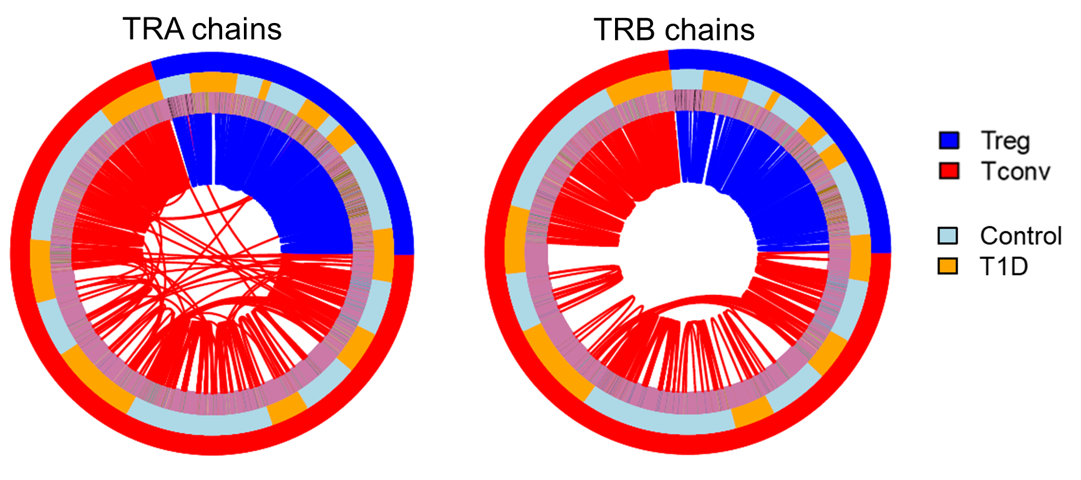
P390: Islet tregs are expanded but share few tcrs with tconv cells
Sharing was defined as identical nucleotide sequence of TRA and TRB chains.
Alex Hu

Slide 6
Overview
Background & Motivation
Current Study
Goal
Design
Data & Results

Slide 7
Question
Is the finding of little TCR sharing between Islet reactive Tconv and Treg similar in microbial reactive cells?
Microbial (foreign)
IAR
Tconv
Tconv
TCR Clones
?
Treg
Treg

Slide 8
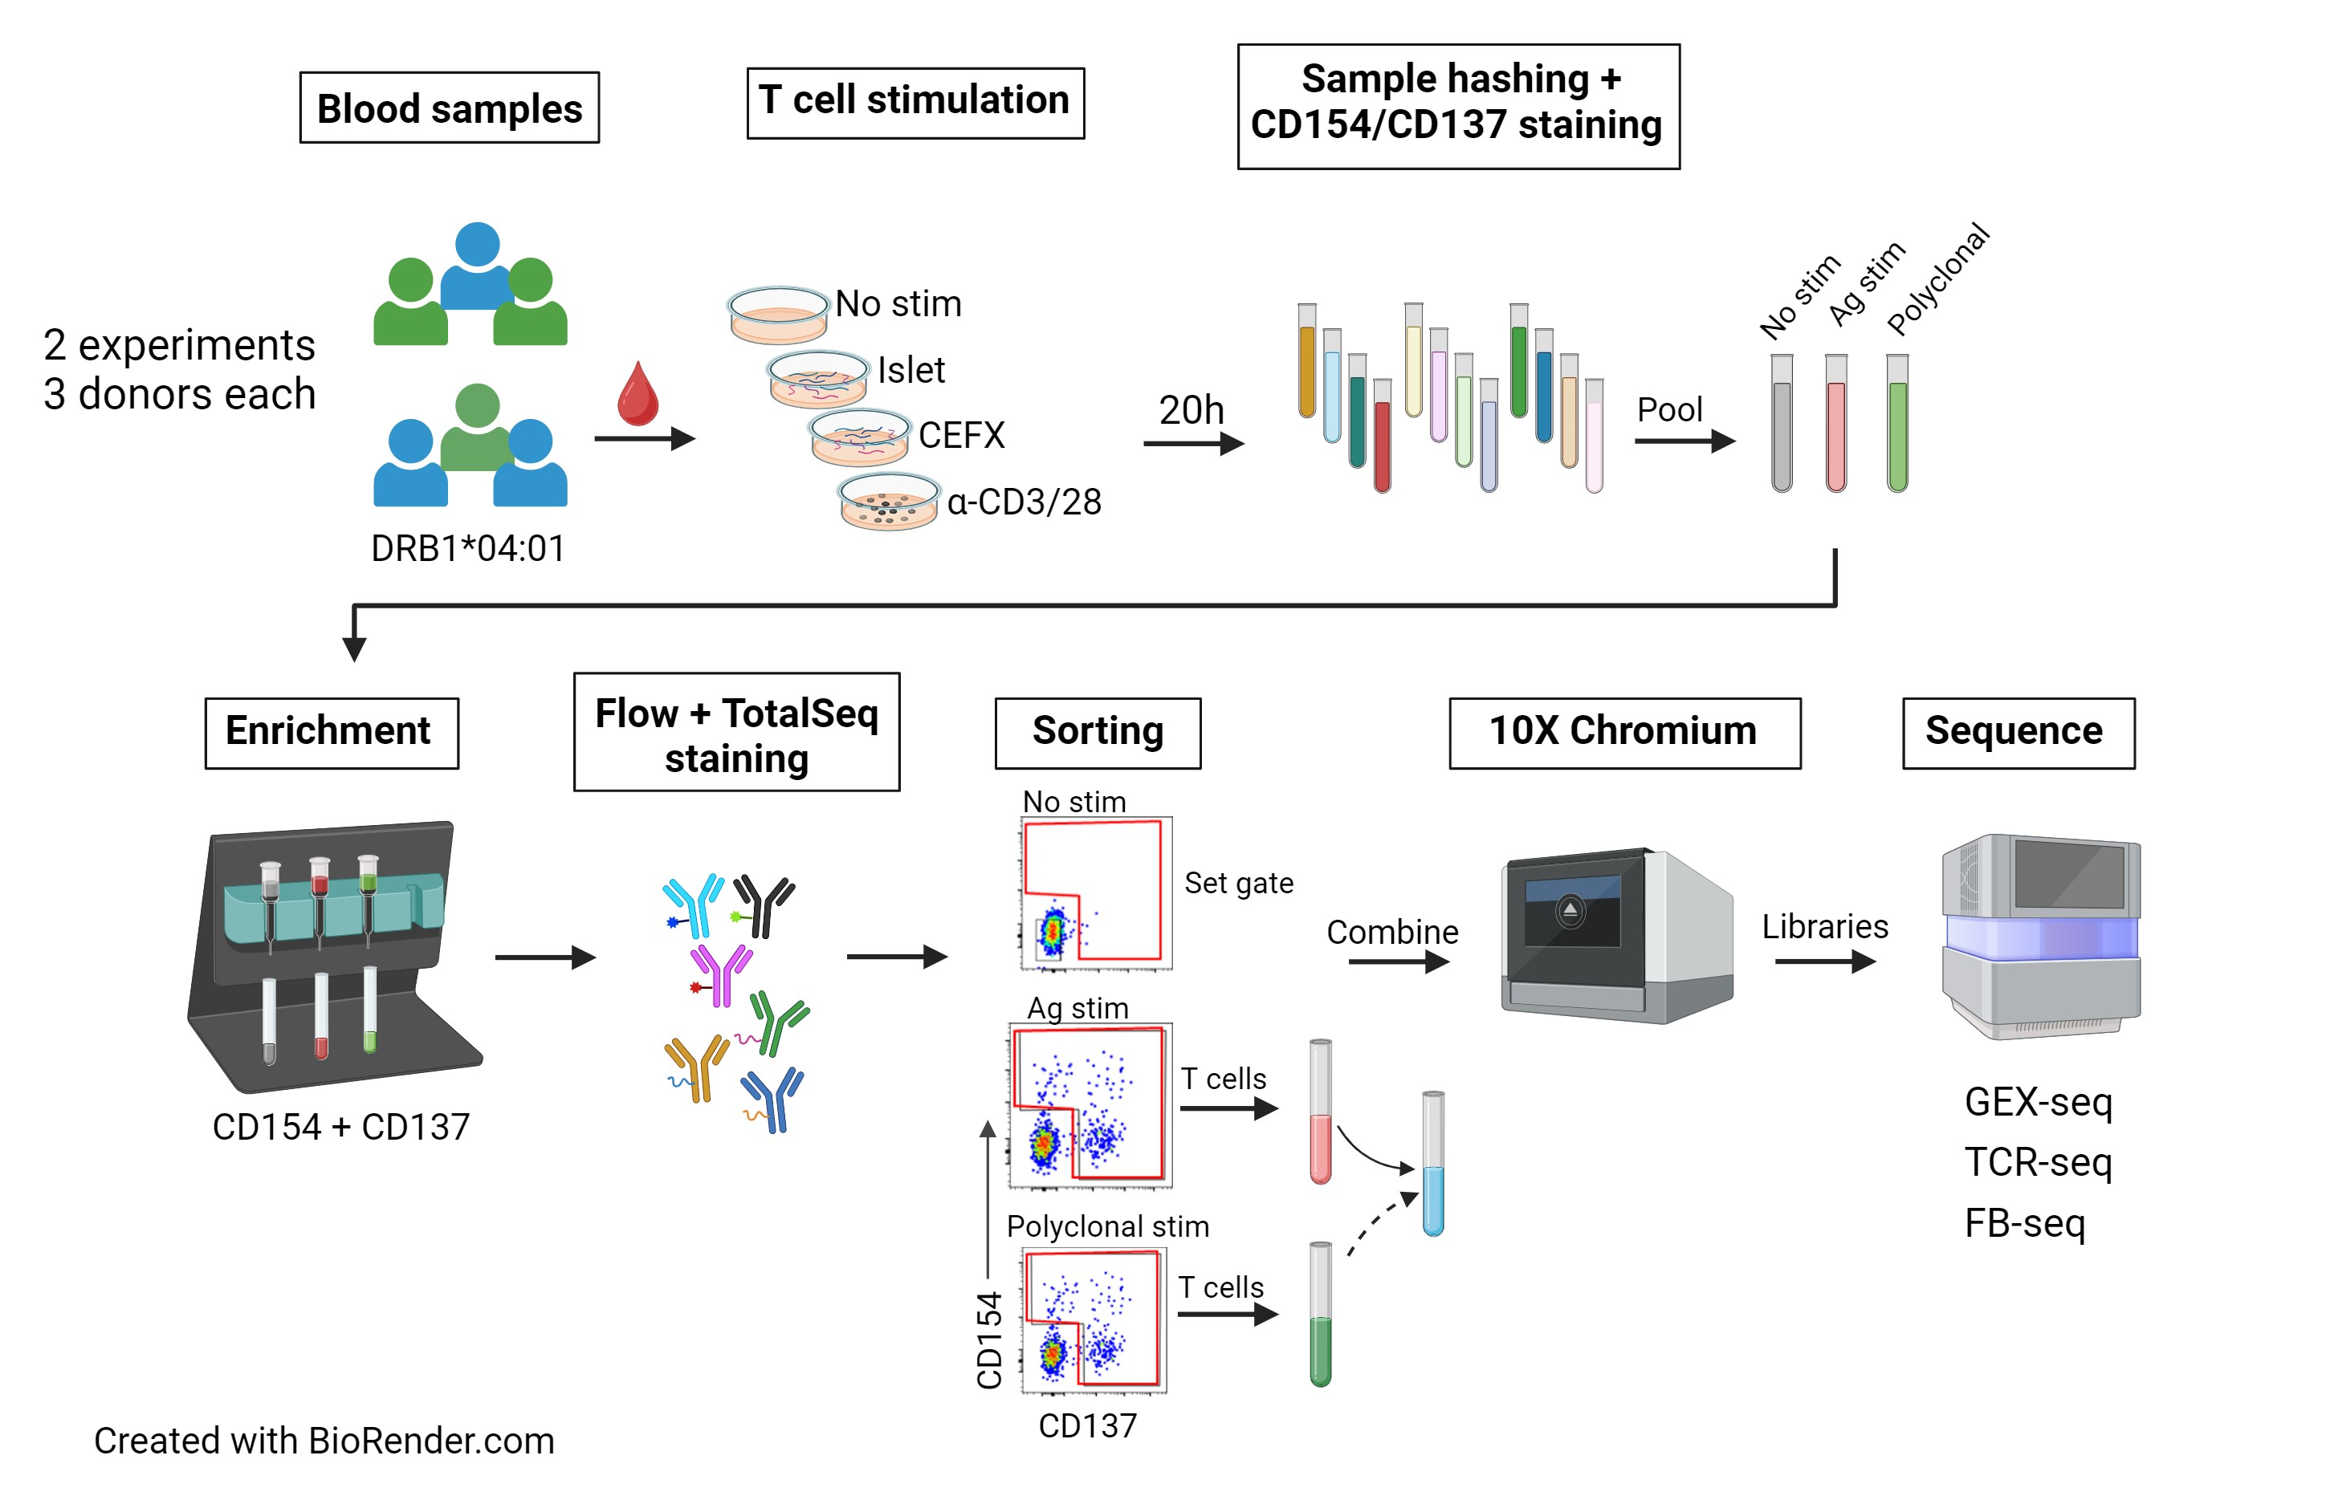
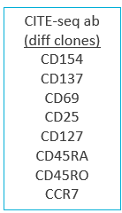
Final Experimental workflow
Janice Chen
Notes:
GEM-X for libraries (5' GEX/TCR/ FB)
Illumina (NextSeq2000, P4 XLEAP) for sequencing
In-house alignment pipeline]

Slide 9
Antibodies
Flow Abs | TotalSeq Abs | Hastag Abs
CD3 |  | Anti-human Hashtag 1
CD4 |  | Anti-human Hashtag 2
CD8 (dump) |  | Anti-human Hashtag 3
CD19 (dump) |  | Anti-human Hashtag 4
CD14 (dump) |  | Anti-human Hashtag 5
CD56 (dump) |  | Anti-human Hashtag 6
LD |  | Anti-human Hashtag 7
CD154 | CD154 | Anti-human Hashtag 8
CD137 | CD137 | Anti-human Hashtag 9
CD69 (DMSO only) | CD69
 | CD25
 | CD127
 | CD45RA
 | CD45RO
 | CCR7
 | Mouse IgG1, κ
Janice Chen

Slide 10
Overview
Background & Motivation
Current Study
Data & Results
Data QC + Metrics
TCR Recovery
GEX Visualization
TotalSeq/FB

Slide 11
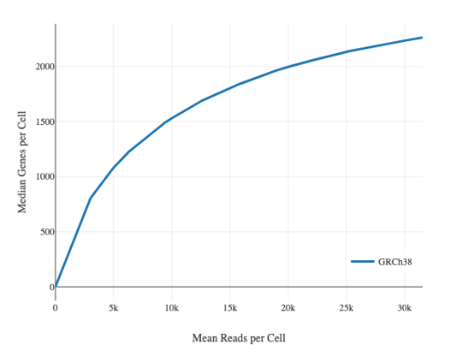
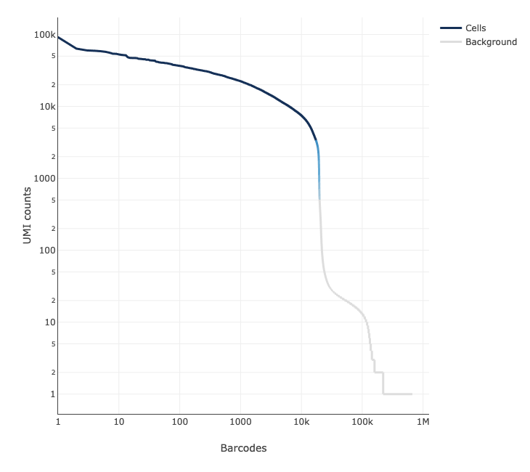
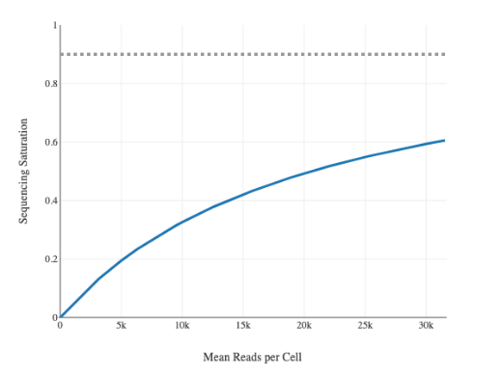
Qc overview – rna-seq
Genes vs reads/cell
Cell viability: 91%
Lower than ideal
37,420 cells recovered/ 106K loaded – between 2 batches (35%)
overloaded – target should be 20-30K per lane (capture ~20K from 10X)
2,310 median genes/cell
24,244 total genes detected
8,117 Median UMI counts/cell
GEMS with cells
Sequencing saturation
T Edwards

Slide 12
Qc - rnaseq
nFeatures/Cell are high
Preliminary & unpublished: do not cite or distribute.

Slide 13
Qc - rnaseq
Samples with higher mitochondrial read counts are lower in genes
Preliminary & unpublished: do not cite or distribute.

Slide 14
Hashtag demultiplexing
Most hashtags had good separation
37,420K cells → 1,873 Multiplet GEMs and 108 Negative GEMs identified and removed
CD3/28 hashtags were diluted

Slide 15
Cells passing qc for each hashtag
Exp | Donor Id | Islet | CEFX | CD3/28
 | # cells stimulated | 30e6 | 20e6 | 2e6
1 | CerosalettiLab448473 | 240 | 3111 | 493
1 | CerosalettiLab632811 | 388 | 1334 | 604
1 | CerosalettiLab839987 | 263 | 8612 | 279
2 | CerosalettiLab942655 | 244 | 12609 | 439
2 | CerosalettiLab1059994 | 114 | 1437 | 42
2 | CerosalettiLab1464776 | 153 | 1884 | 160
Even with decreased recovery, we still recovered more cells than previously with PlateSeq
CEFX was down-sampled to match Islet for downstream analysis
Although similar numbers were set up within each stim, recovery varied
Sort stims separately or use fluorescent barcoding to ensure more even numbers
We could have stimmed fewer cells for CEFX and more for islet
T Edwards

Slide 16
Productive TCR pairs found in 80% of cells
Similar results as PlateSeq
Islet
CEFX
CD3/CD28
None ~ 5%
Alpha only ~ 9%
Beta only ~ 6%
Both ~ 80%
Removed: 35 iNKT, 11 MAIT cells, 1065 multiplets

Slide 17
How scRNAseq processing often happens
Data Clustered
Bioinformatician fiddles with hyperparameters until satisfied/tired/out of time
Exchange $ + time + ATP for Data
Clusters Visualized
The UMAP does not spark joy in the Investigator
Human Approves Groupings
Write Grant
DiffExp, GSEA, etc
Notes:
Used to choose how your data (in this case, cells) are grouped.
These groupings determine downstream analyses like diffexp, GSEA
They influence how the researcher understands the data
The human is in the analysis loop, and the visualizations effect the human

Slide 18
Similar workflow with more reproducibility + investigator agency
Data Clustered in Many Ways
Clustering Options Visualized + Paired with Relevant Info
Human Selects Groupings
DiffExp, GSEA, etc

Slide 19
Rnaseq clustering + umap projection optimization
Optimize RNA clusters with consensus of unsupervised clustering metrics.
Hyperparameters: findNeighborsDim, findClustersRes
Metrics: Davies-Bouldin, Calinski-Harabasz, Silhouette Score
Optimize 2D UMAP embedding with scDEED.
Hyperparameters: min.dist, n_neighbors
Metric: minimize # of ‘dubious’ cell embeddings
Choose between ‘best’ clusterings & embeddings for a range of reasonable numbers of clusters.
Note: optimizations performed via grid search—likely could be improved with an optimization algorithm. TBD.
Xia, L., Lee, C. & Li, J.J. Statistical method scDEED for detecting dubious 2D single-cell embeddings and optimizing t-SNE and UMAP hyperparameters. Nat Commun 15, 1753 (2024). https://doi.org/10.1038/s41467-024-45891-y

Slide 22
Notes:
EVALUATED ON THE 2D UMAP EMBEDDING
THESE PUSH FOR READABILITY OF THE UMAP, WHICH MAY NOT BE FOR THE BEST.

Slide 23
Characteristics of selected clustering metrics
Davies-Bouldin Index
Maximize pairwise inter-cluster distances and minimize intra-cluster variances
Can favor lower numbers of clusters, sensitive to outliers.
Calinksi-Harabasz Index
Maximize inter-cluster variance and minimize intra-cluster variances.
Can favor solutions with more clusters, sensitive to outliers.
Median Silhouette Score
Minimize intra-cluster distances and maximize distances to nearest cluster.
Not biased towards particular cluster numbers, robust to outliers.
Computationally expensive.

Slide 24
Optimal hyperparameters for n = 3 to n = 10 clusters
N_clusters | findNeighborsDim & dims (UMAP) | findClustersRes | min.dist | n_neighbors | Mean cluster evaluation metric
3 | 20 | 0.05 | 0.2 | 40 | 0.937
4 | 16 | 0.1 | 0.4 | 5 | 0.817
5 | 16 | 0.2 | 0.4 | 5 | 0.801
6 | 5 | 0.3 | 0.9 | 5 | 0.571
7 | 14 | 0.25 | 0.6 | 5 | 0.649
8 | 16 | 0.5 | 0.4 | 5 | 0.602
9 | 5 | 0.5 | 0.9 | 5 | 0.519
10 | 7 | 0.75 | 0.9 | 5 | 0.379

Slide 25
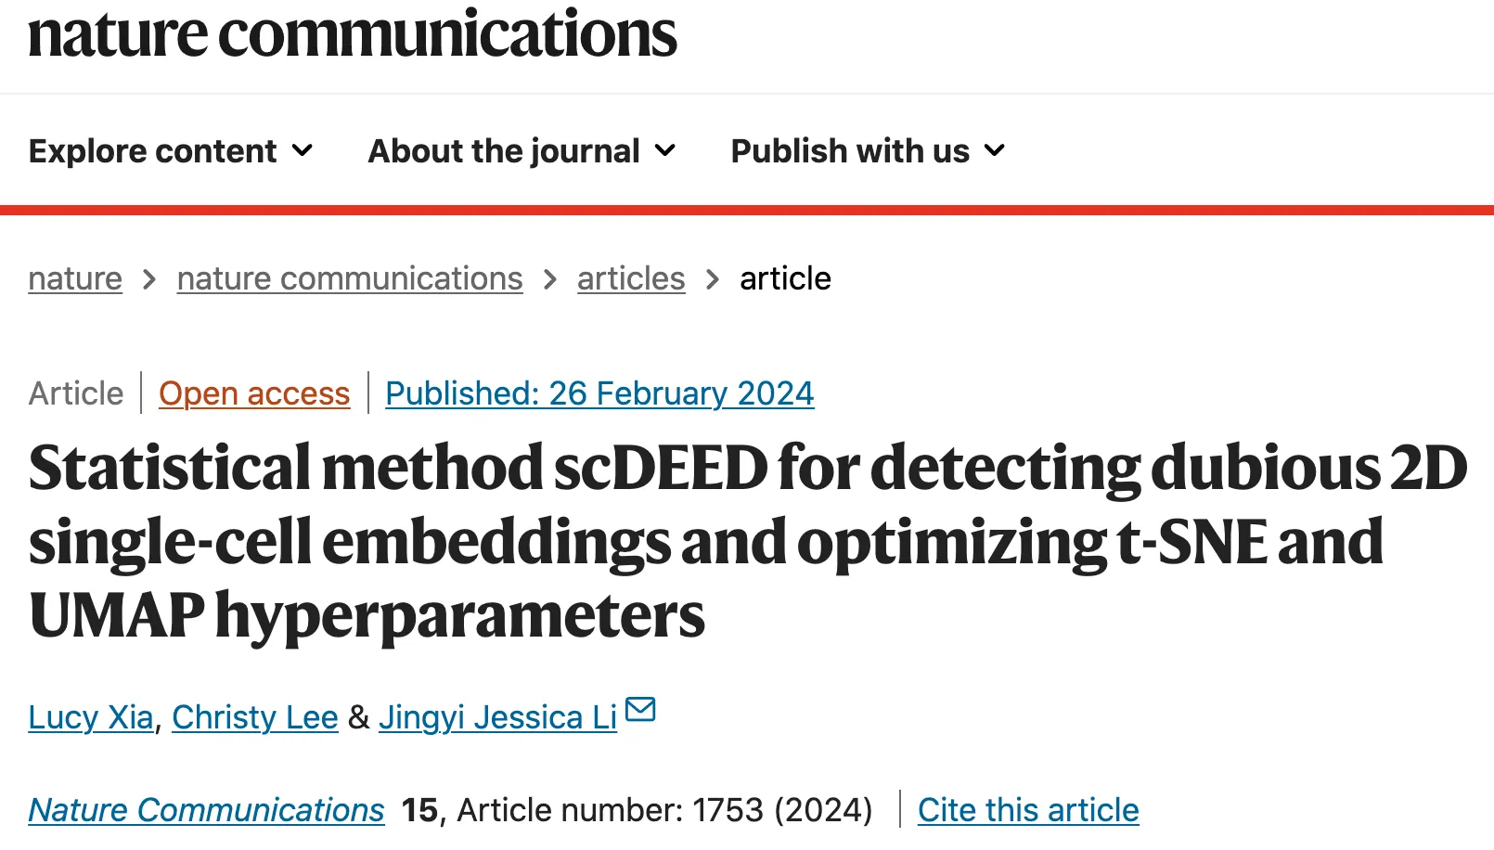
H. Bolouri shared in #biocor on 20240416
“The improvements achieved with this method are not stunning, but may be useful when a UMAP looks noisy, or when cell distributions on a map are critical to your findings.” -Hamid

Slide 26
optimized 7-cluster option
Mean scaled cluster eval metric = 0.647/1 (DB, CH, and med. sil. score)
6
5
1
0
3
2
4

Slide 27
Scdeed embedding designations
16/4821 ‘dubious’ cell embeddings
6
6
5
5
1
1
0
0
3
4
2
3
2
4

Slide 28
7-cluster, split by stimulation

Slide 29
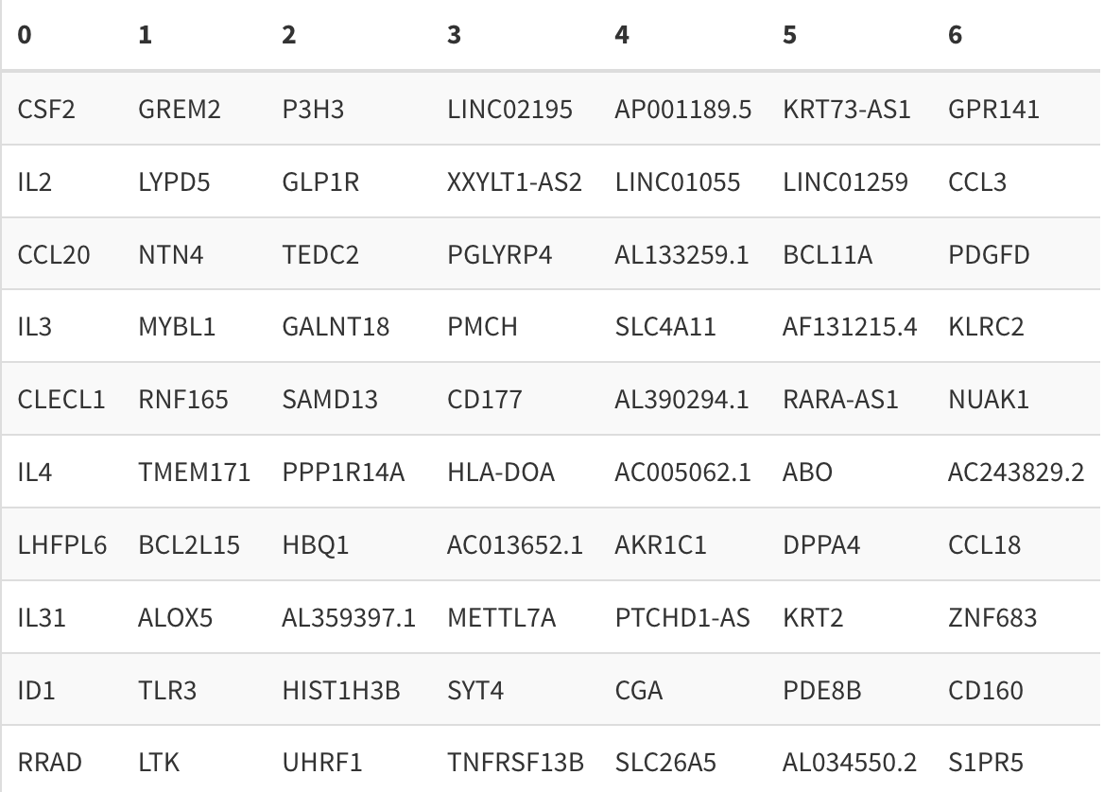
Top 10 cluster-defining genes
Top 10 cluster-defining genes (up relative to other clusters)
6
5
1
0
3
2
4

Slide 30
Top 10 cluster-defining genes dotplot & diversity metric

Slide 31
Mean p390 module expression & cell type inference
Highly activated Tconv?
Cytotoxic CD4 cells?
6
5
1
Treg
0
Tconv
3
2
4

Slide 32
P390 module gene expression
Highly activated Tconv?
Cytotoxic CD4 cells?
6
5
1
Treg
0
Tconv
3
2
4

Slide 33
P390-based treg & Tconv assignments generally agree with Celltypist
Highly activated Tconv?
Cytotoxic CD4 cells?
6
5
1
0
Treg
3
2
Tconv
4

Slide 34
Celltypist cell calling, split by stimulation

Slide 35
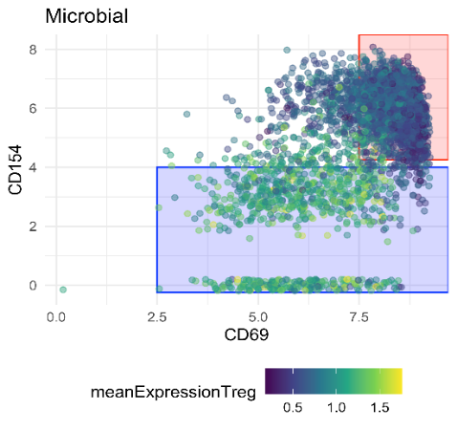
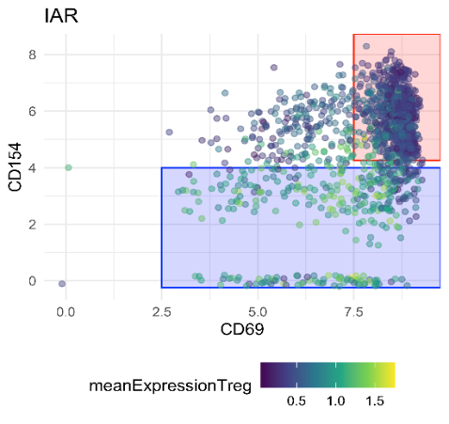
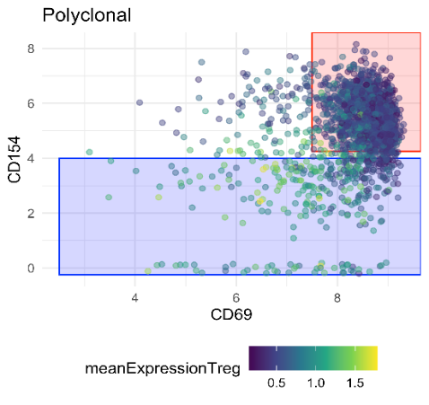
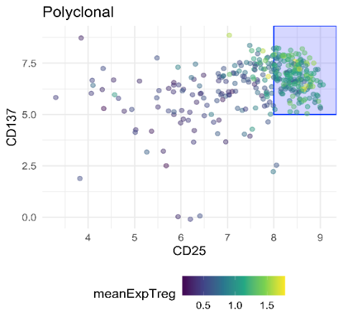
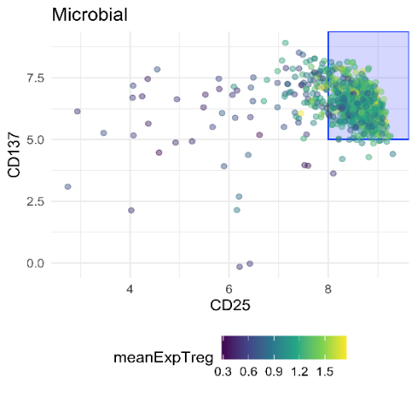
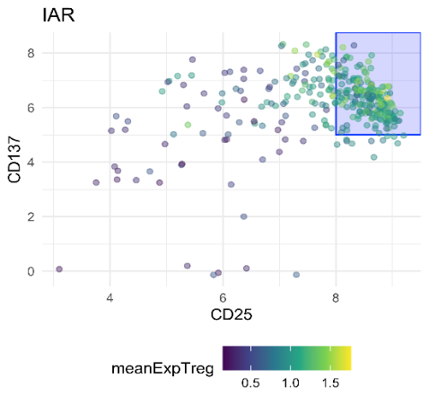
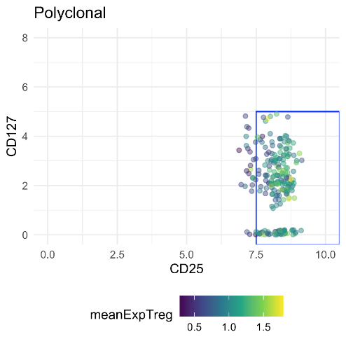
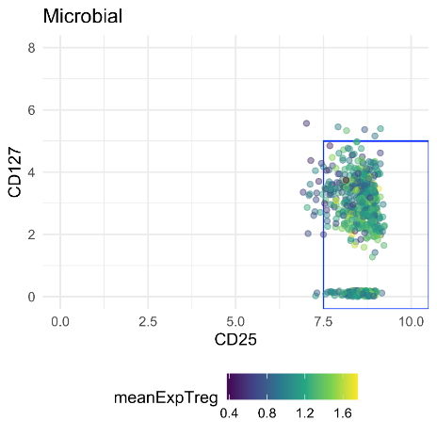
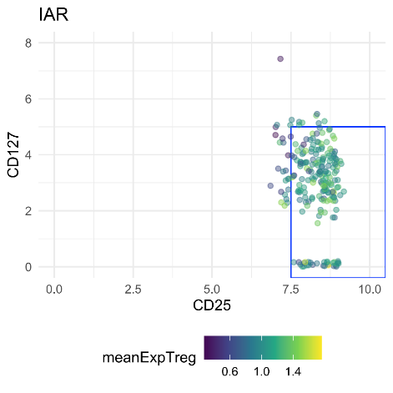
CITE-Seq “gating” on AG reactive cells
Microbial
Islet
Polyclonal
CD154
CD69
CITE-seq antibody expression
Gating without DMSO control is slightly more difficult
Should we use RNAs-q data to refine gating on ag specific Tconv and Tregs or just use CITE-seq ab like previous exp?
CD137
CD25
CD127
CD25

Slide 36
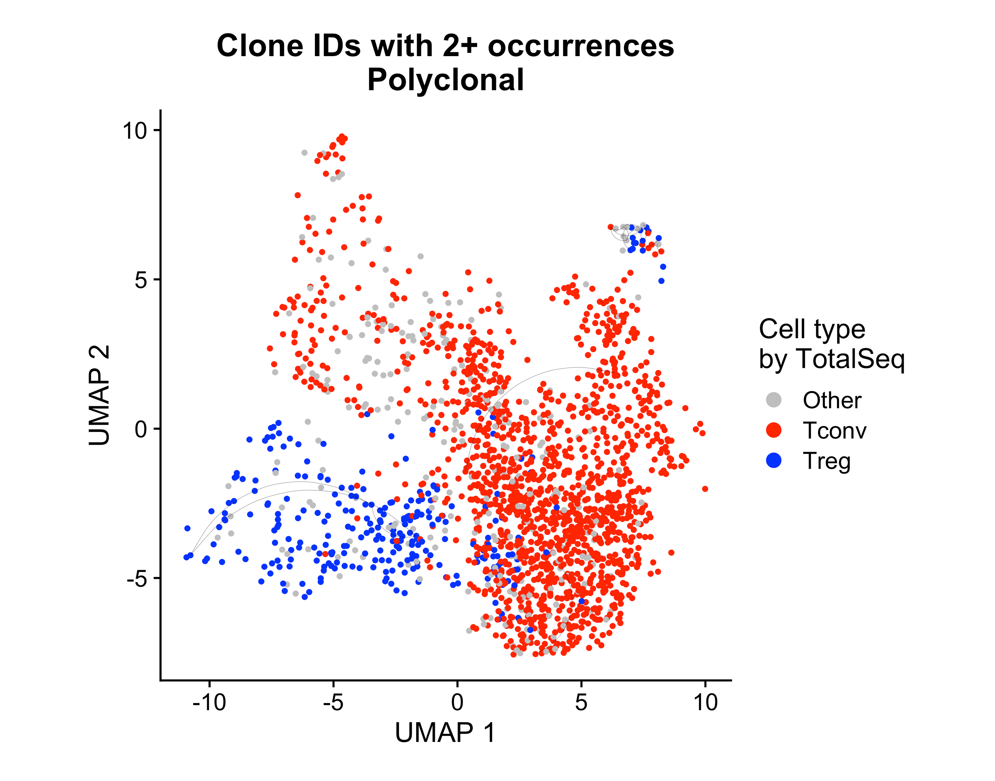
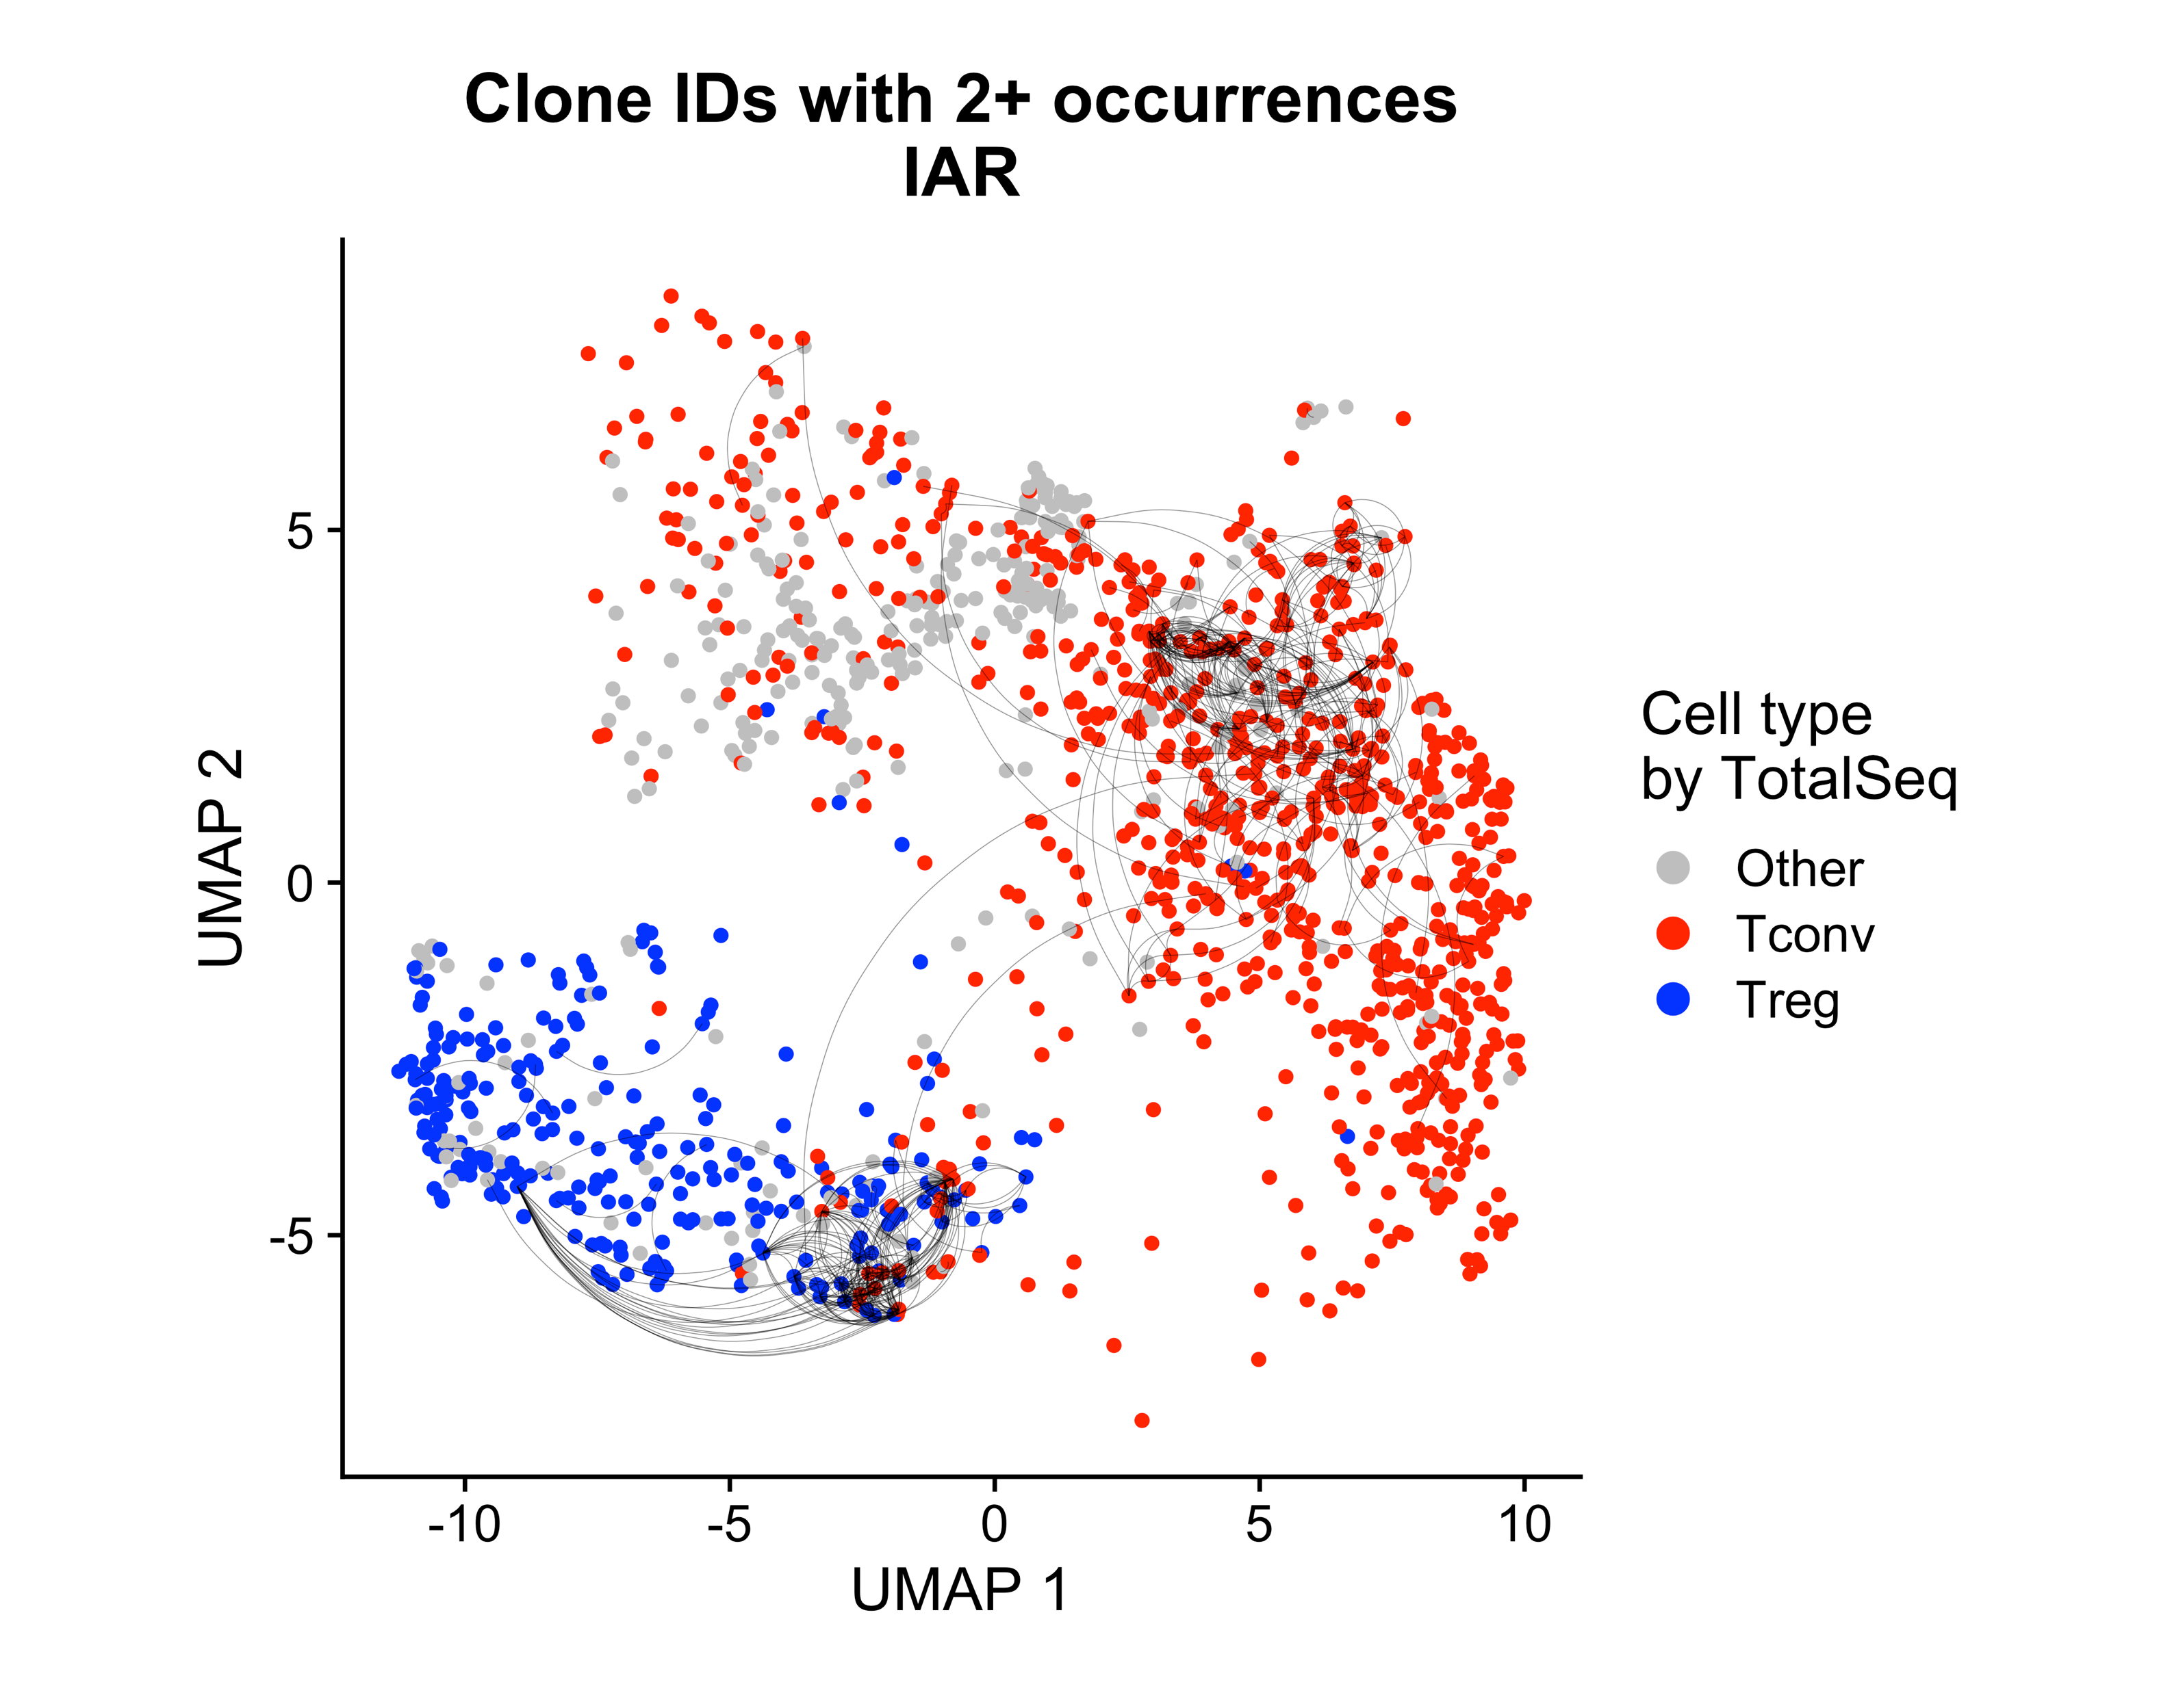
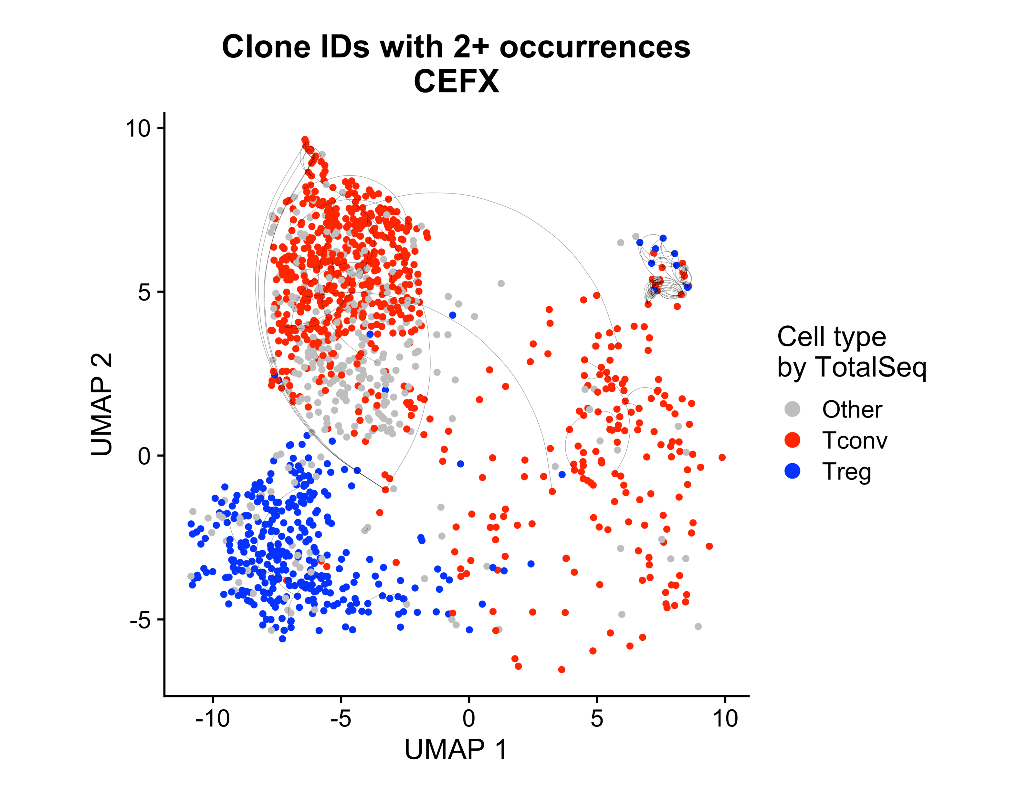
Little TCR sharing between Islet and CEFX Tconv and Tregs
Sharing between 2 or more TCRs
Islet
Airline plots suggest similar results in foreign antigen: there is minimal sharing between Treg and Tconv TCR repertoires
Clonal expansion within cell types for ag specific stimulation but not polyclonal stimulation

Slide 37
Conclusions and next steps
10X of islet and CEFX AIM+ cells was successful
10X cell capture was low, 35%, but chip was loaded on high end (50K)
Polyclonal stimulated CD4 T cells worked well as a landscape of all CD4 T cells as they co-cluster with AIM stimulated cells
Treg and Tconv cells could be distinguished transcriptionally
Antigen activated cells could be gated using CITE-seq surface expression (ongoing)
Tconv and Treg cells were expanded with CEFX and islet stimulation, but not polyclonal sitmulation
TCR sharing is minimal between CEFX and islet Treg and Tconv cells
Next steps
Compare transcript phenotypes in Tregs and Tconv cells in islet vs CEFX stims

Slide 38
Acknowledgements
Bioinformatics Core
Hannah DeBerg
Stephan Pribitzer
Matt Dufort
Alex Hu
Matt Lawrence
Ty Bottorff
Andrew Koval
Kenneth Lai (2023 intern)
Genomics Core
Vivian Gersuk
Kimberly O’ Brien
CATA Core
Adam Wojno
Cerosaletti Lab
Karen Cerosaletti
Janice Chen
Software & Data Management
Charlie Quinn
Alex Walker
Adarsh Manjunath
Anna Bjork
Robyn Meshulam
Seattle Children’s Research Center
David J. Rawlings

